Slide 1
Anand Agricultural University, Anand
Tomato Leaf Disease Detection Using Deep Learning
Submitted By
Meet Borda
ID: 202319008​
Deep Pethani
ID: 202319011​
Nidhi Gusai
ID: 202319015​
Divya Prajapati
ID: 202319024
Submitted To
Dr. Kalpesh P. Patel
(Department of Agricultural Statistics, BACA, AAU)

Slide 2
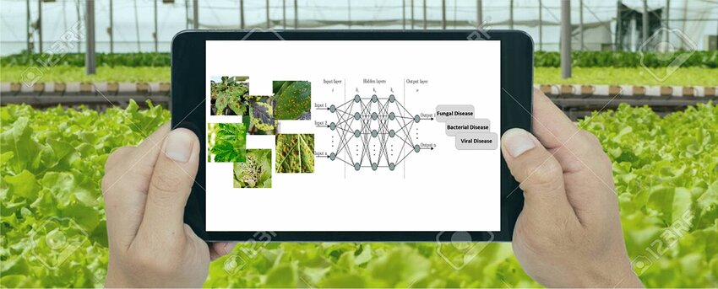
Contents
Crop Biology
Objective
Data
Methodology
Deep Learning Techniques for Disease Prediction
Results
Conclusion

Slide 3
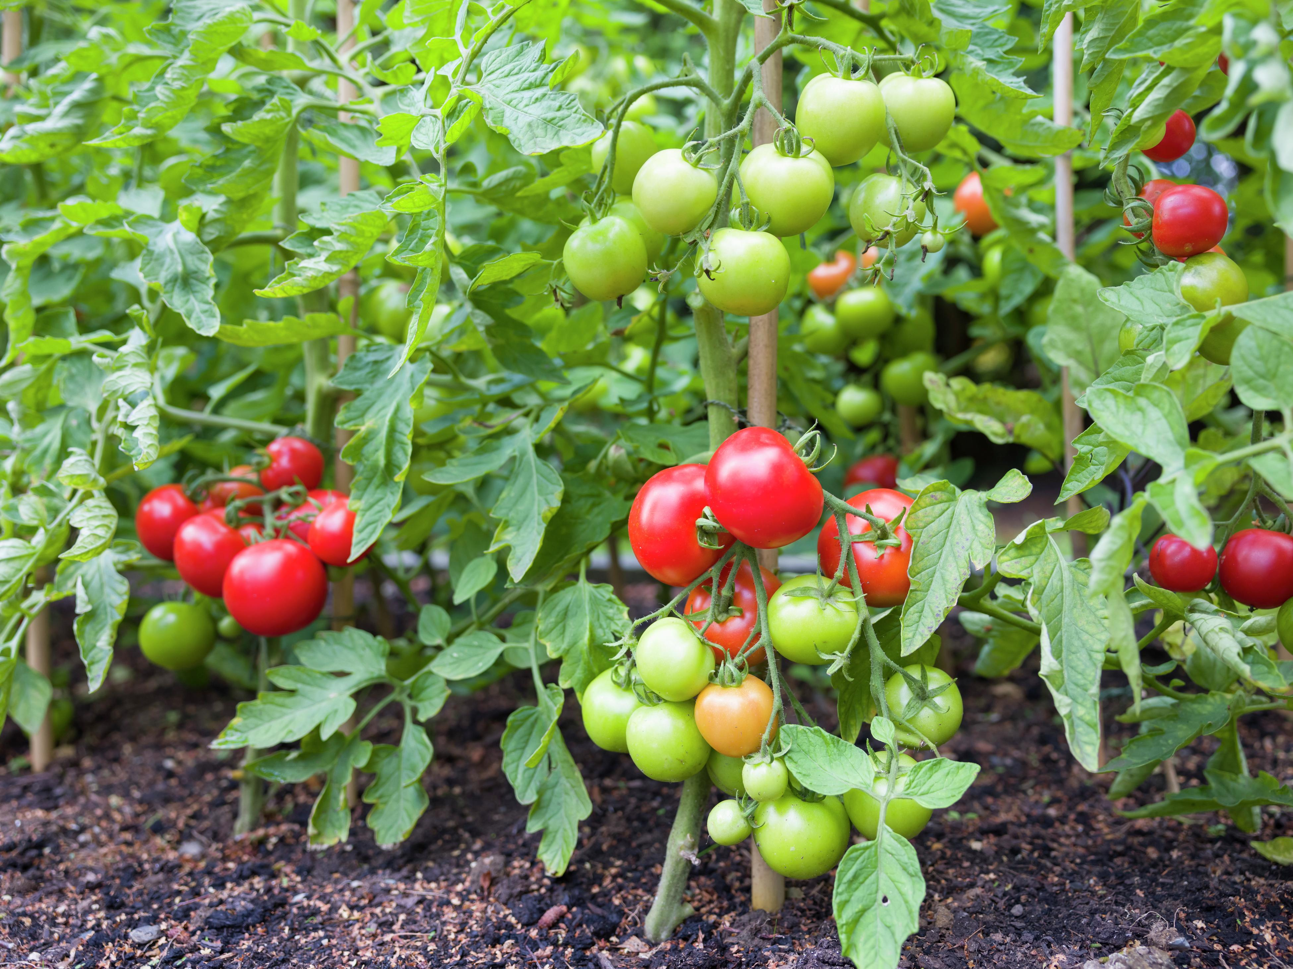
Crop Biology
Scientific Name: Solanum lycopersicum
Optimum Temp. : 21°C - 29°C
Type of soil : Loamy Soil
Optimum Relative Humidity : 60 – 70%
Optimum Soil Temperature : 18°C - 24°C
Optimum Yield : 45,000 - 67,000 kg/ha

Slide 4
Objectives
To develop different DL models for leaf disease detection of Tomato crop.
To evaluate the performance of the models for disease detection.
To explore the architecture and performance of the lightweight model.

Slide 5
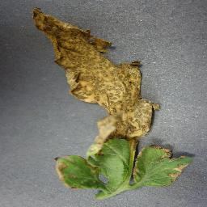
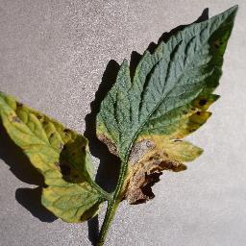
Data
Description of dataset:
1. Dataset Source: Kaggle
2. Total Images: 26500
3. Number of Classes: 10
4. Training Images: 22000 (per class 2200 images)
5. Validation Images: 4500 (Per class 450 images)

Slide 6
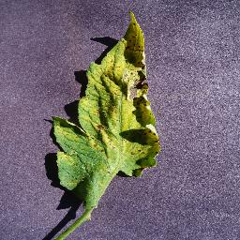
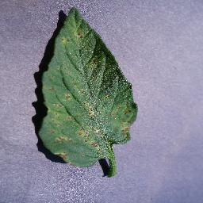
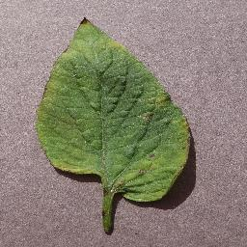
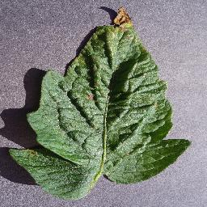
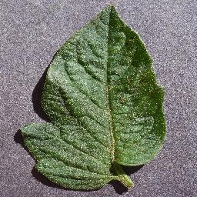
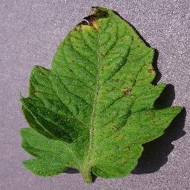
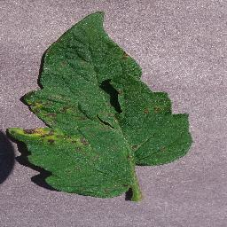
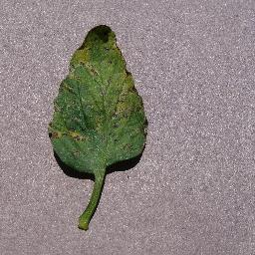
Glimpse of the Data

Slide 7
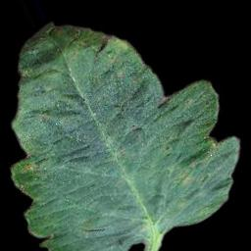
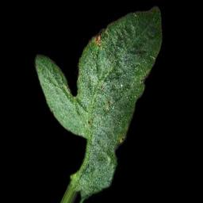
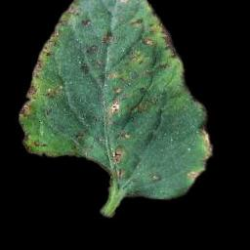
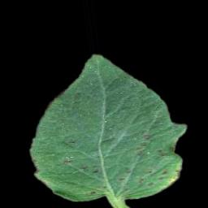
Data Processing
Removing backgrounds or unwanted parts from images in a dataset using Photoshop involves isolating and keeping only the main object inside images.
Image augmentation enhances model learning by creating variations of existing images through techniques like rotation, flipping, zooming, and color adjustments. This increases the diversity of training data, helps prevent overfitting, and improves the model's ability to generalize to new, unseen images, leading to better performance.

Slide 8
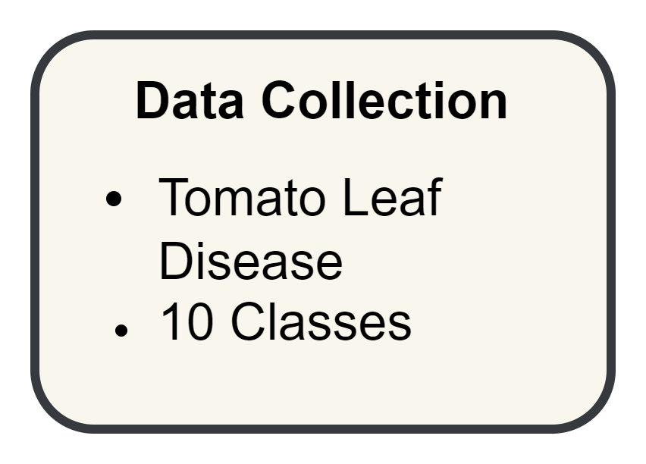
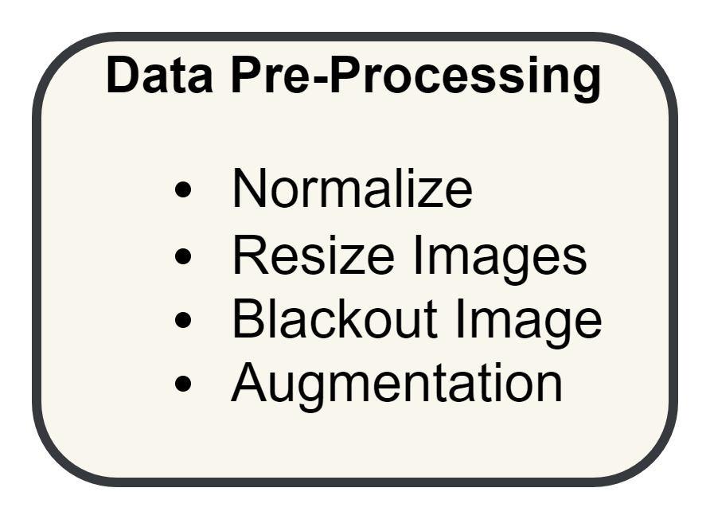
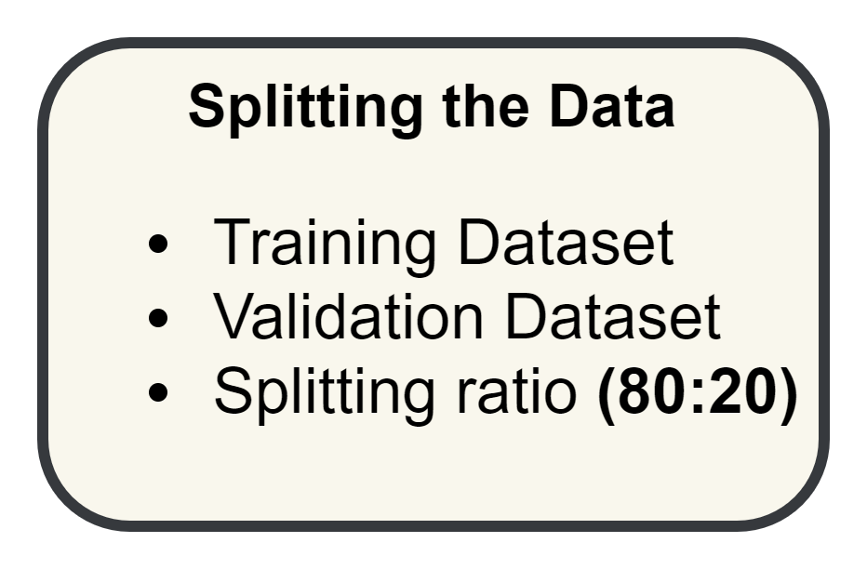
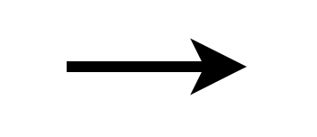

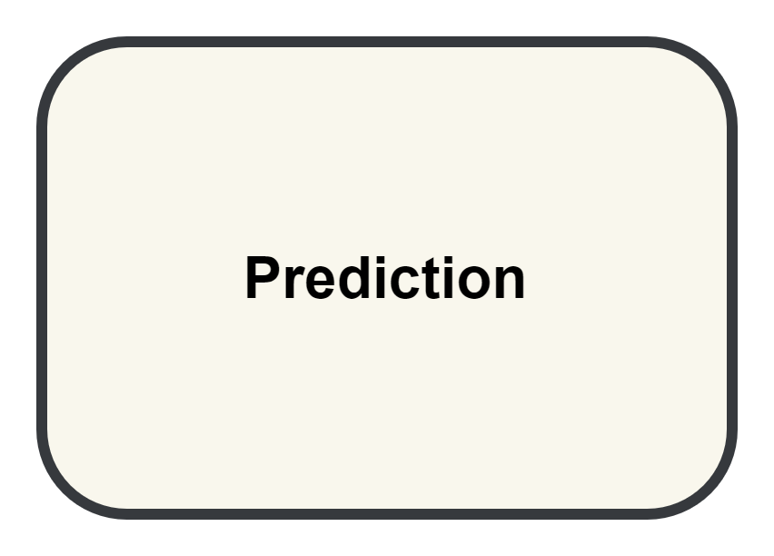
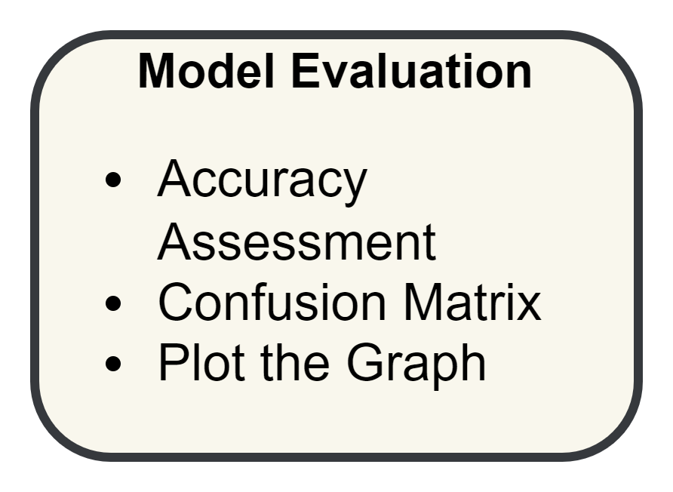
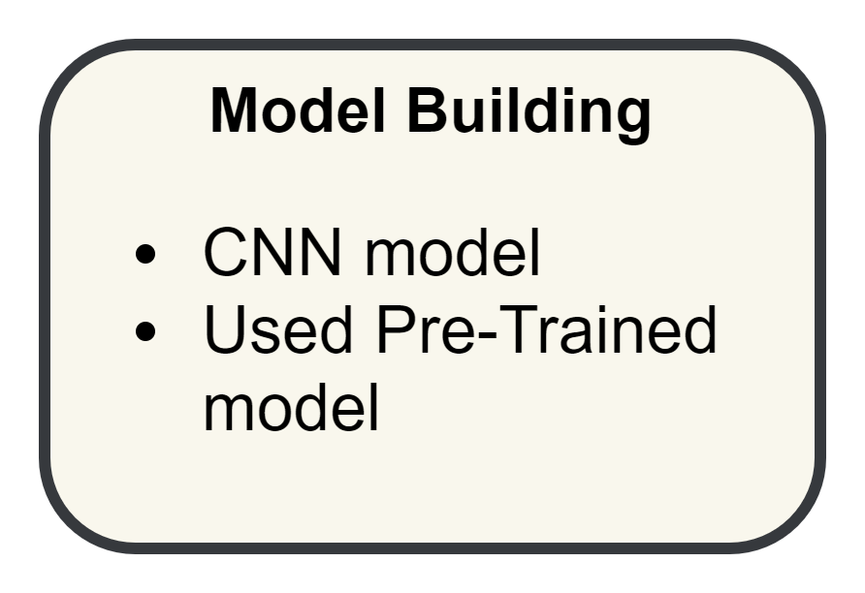
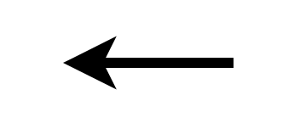
Methodology

Slide 9
Architecture Used
Feature | Proposed CNN | VGG16 | DenseNet | MobileNet
Architecture | Standard convolutional network | Pre-trained deep CNN | Deep CNN with dense connections | Lightweight CNN optimized for mobile
Parameters | Varies (depends on architecture) | 138 million | 8 million (for DenseNet-121) | Around 4 million (for MobileNetV1)
Training Time | Varies (depends on model complexity) | Longer due to depth | Longer, but more efficient parameter usage | Faster due to fewer parameters and efficient depth wise separable convolutions
Performance | Good, but varies by architecture | High accuracy on various tasks | Often outperforms VGG16 due to better information flow | Good accuracy with reduced computational cost, suitable for mobile and edge devices

Slide 10
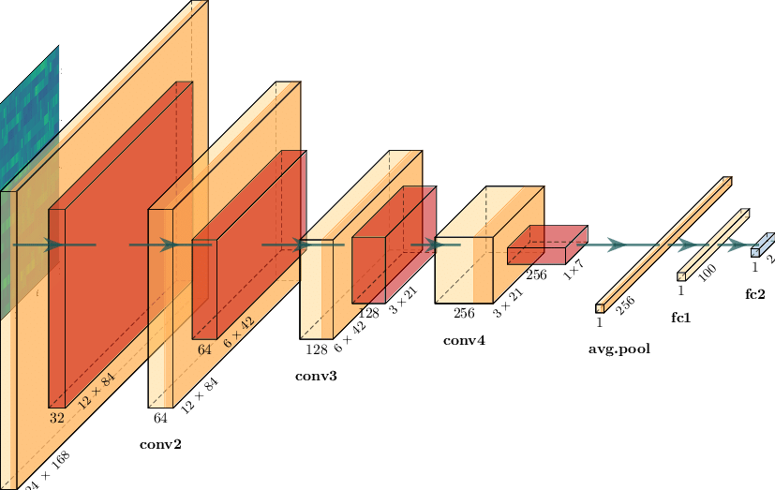
Proposed CNN Model Architecture

Slide 11
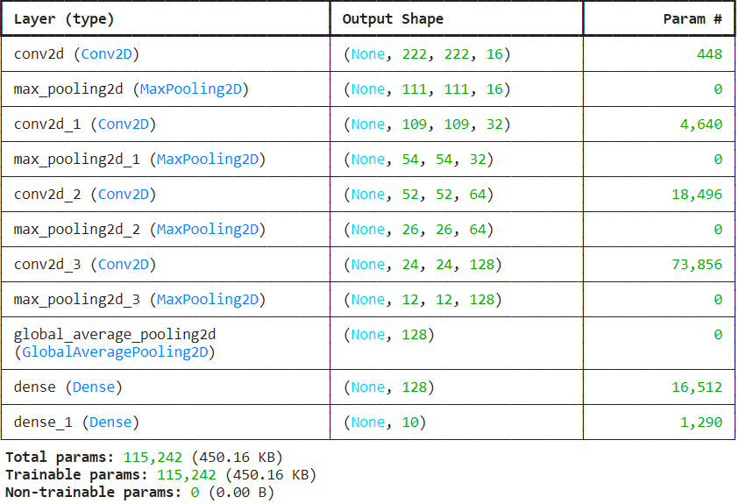
Parameters

Slide 12
Hyper Parameter of Proposed CNN Model
Hyper Parameters | CNN
Convolutional Layers | 4
Max Pooling Layer | 4
Global Average Pooling Layer | 1
Dense Layer | 2
Epochs | 150
Activation Function | ReLU, SoftMax
Callbacks | Checkpoint, Early Stop
Optimizer | Adam (Default learning rate = 0.001)
Image Size | 224 x 224 x 3
Batch Size | 32

Slide 13
Terms used in Proposed CNN Model Architecture
Convolutional Layers: These layers scan the images to detect important features like edges and textures.
Max Pooling Layer: These layers reduce the size of the feature maps by keeping only the most important information, which helps to simplify the model.
Global Average Pooling Layer: This layer reduces the size of the feature maps even further by taking the average value from each map, which helps the model focus on the overall pattern.
Dense Layer: These layers are fully connected and are used for making final decisions, such as classifying the image.
Epochs: This is the number of times the entire dataset is passed through the model during training. More epochs can help the model learn better, but too many can lead to overfitting.

Slide 14
Callbacks (Checkpoint, Early Stop):
- Checkpoint: This saves the model at certain points during training so that you can resume training later if needed.
- Early Stop: This stops training early if the model stops improving, preventing overfitting.
Activation Function (ReLU, SoftMax):
- ReLU: A function that helps the model learn by turning off neurons with negative output, making training faster and more effective.
- SoftMax: A function used at the end of the model to convert the output into probabilities, so the model can make a final prediction.
Optimizer: This is the method used to adjust the model's parameters to minimize errors. The Adam optimizer is widely used and adjusts the learning rate during training.
Image Size: This is the size of the input images, with 224x224 pixels and 3 color channels (Red, Green, Blue).
Batch Size: This is the number of images the model processes at a time during training. A batch size of 32 means the model processes 32 images before updating its parameters.

Slide 15
Results
Model | Training Accuracy | Validation Accuracy
Proposed CNN (10000 images) | 0.96 | 0.92
VGG16 | 0.75 | 0.77
DenseNet | 0.76 | 0.80
MobileNet (Teachable Machine Website) | 0.97 | 0.98

Slide 16
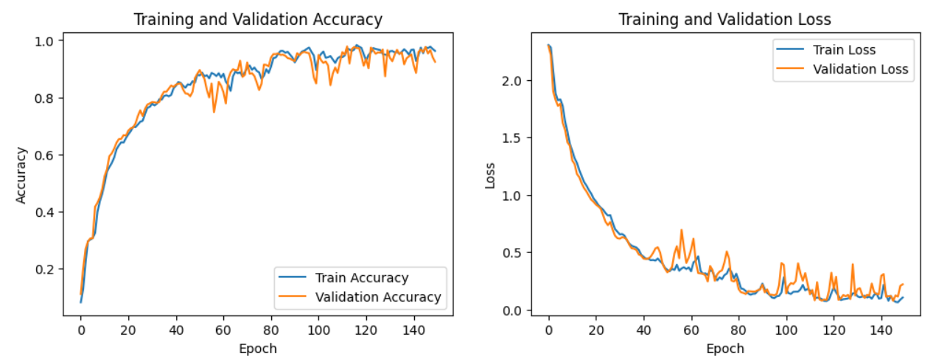
Proposed CNN Accuracy Graph

Slide 17
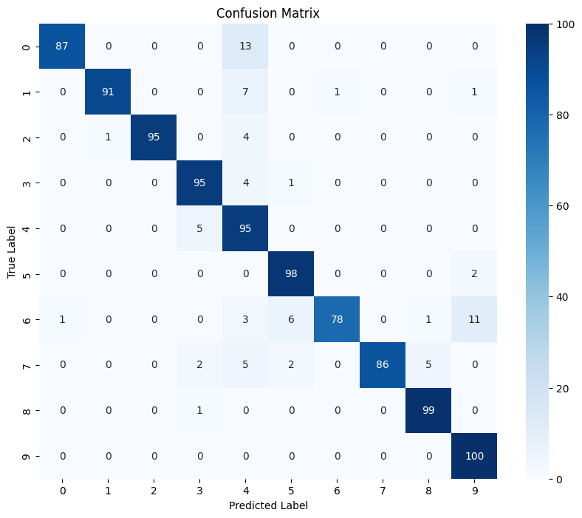

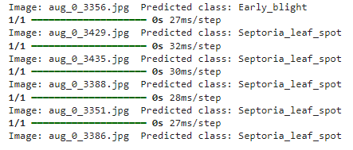
Proposed CNN Model Result

Slide 18
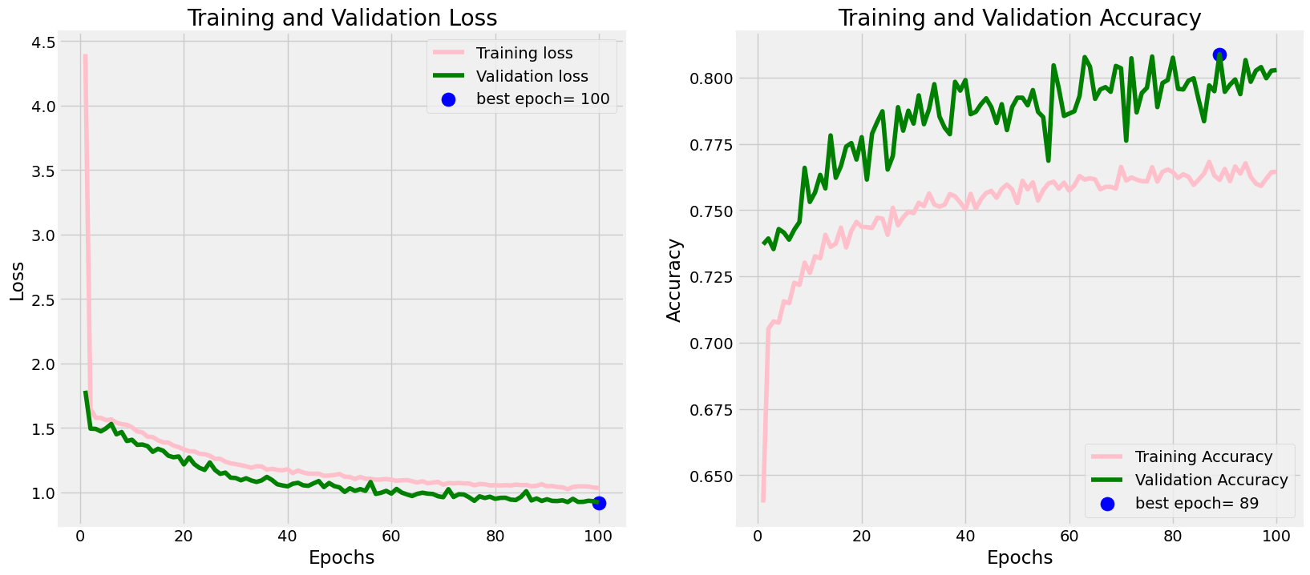
DenseNet Model Result (Pre - Trained)

Slide 19
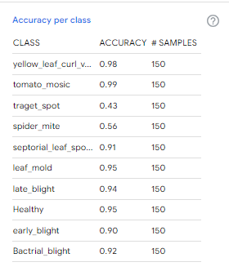
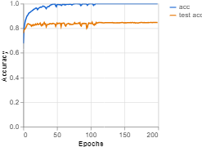
MobileNet Model Result

Slide 20
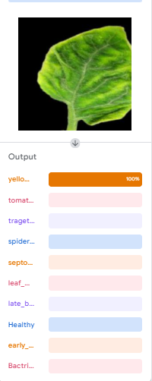
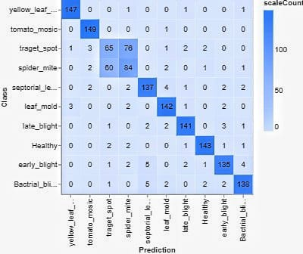

Slide 21
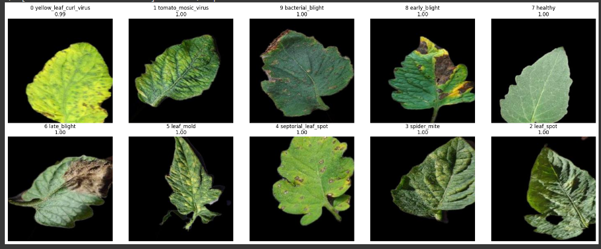

Slide 22
Conclusion
MobileNet Model: Achieved the highest performance with a training accuracy of 0.97 and validation accuracy of 0.98. It is the most suitable for deployment on mobile or edge devices due to its high efficiency and low computational cost.
CNN Model: Showed strong performance with a training accuracy of 0.96 and validation accuracy of 0.92. Performance may vary depending on architectural adjustments.
DenseNet Model: Achieved a moderate training accuracy of 0.76 and a slightly higher validation accuracy of 0.80.
VGG16 Model: Performed adequately with a training accuracy of 0.75 and validation accuracy of 0.77.
MobileNet is the best choice for tomato leaf disease classification, providing an excellent balance of high accuracy and computational efficiency, especially suitable for mobile or edge device applications.

Slide 23


Slide 24
Name | Student ID | Signature
Meet Borda | 202319008
Deep Pethani | 202319011
Nidhi Gusai | 202319015
Divya Prajapati | 202319024

